Slide 1
Colegio San Buenaventura Capuchinos
5ºA

Slide 2
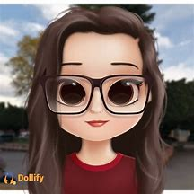
Hello
MY NAME IS MARTINA ,
I AM 10 YEARS OLD,
MY FAvOuRITE SUBJECTs are PHYsical education and maths.
I like playing tennis and judo,
I have got a broteHr called Alvaro,.
Every year i travel to other cities.

Slide 3
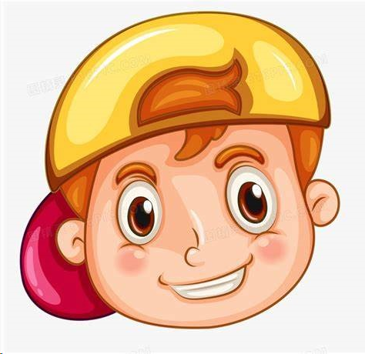
Hello my name is Juan i am 10 year old.
I from spain.
I live Murcia My favourite subject is physical education
And my favourite meal is pizza my
Favourite sport is a football my favourite city is Madrid.

Slide 4
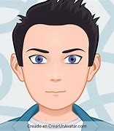
JOAQUIN
hello my name is joaquin fernandez and I am 10 years old. I was born in Murcia. My favorite subject is Physical Education and the least liked is Language. I have a 14-year-old brother named Daniel Fernandez, my father's name is Joaquin Fernandez and my mother's name is Lola Jimenez. My best friend is Alvaro Moreno.

Slide 5
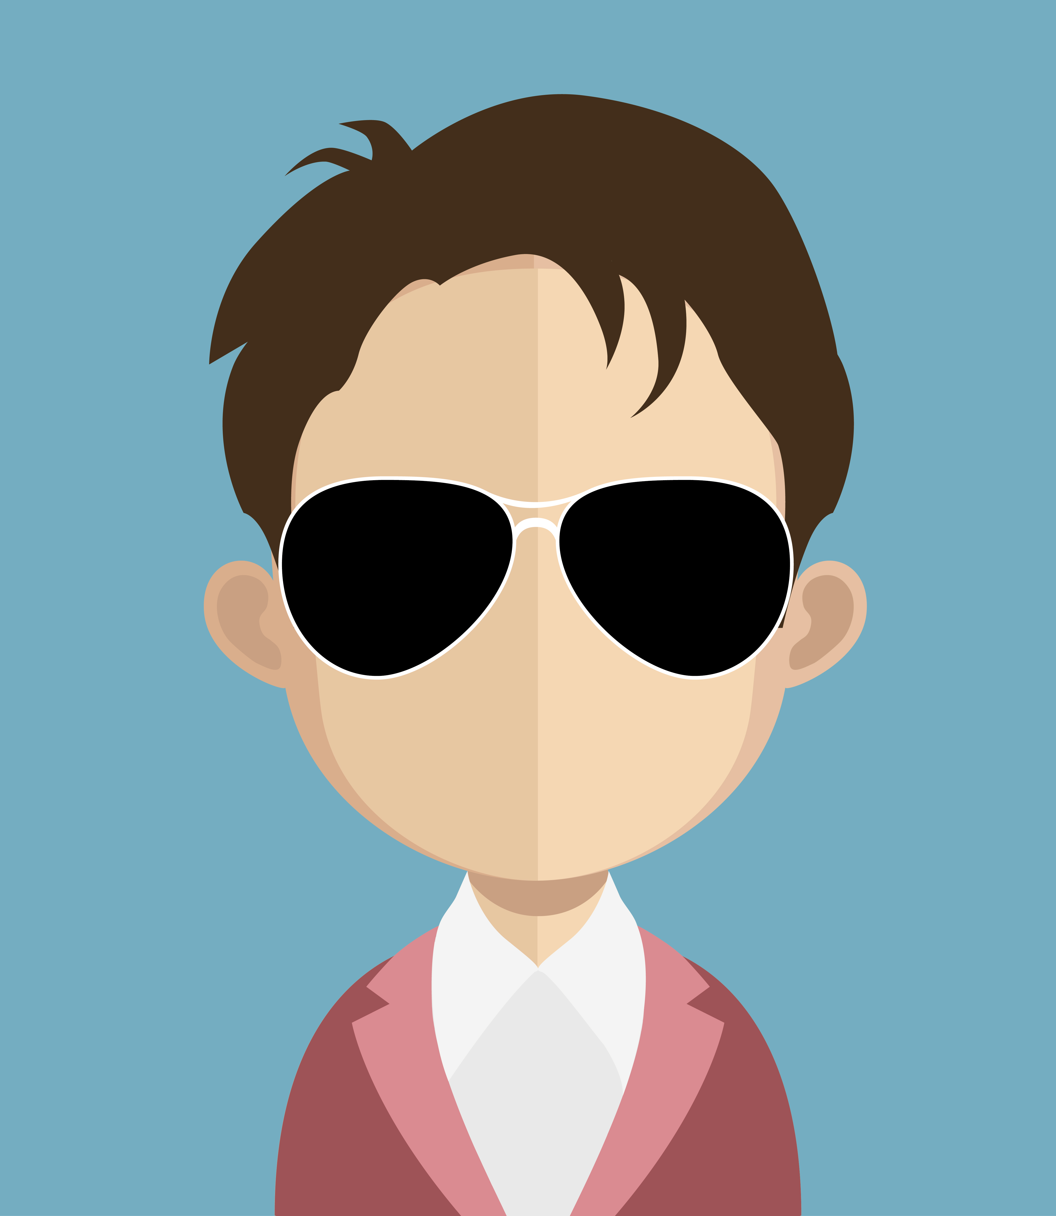
HELLO My name is Javier López
I am 10 years old and I was born 30th of May of 2013
My favorite food is pasta
My favorite subjet is P.E
My favorite color is blue
In my free time I'm reading or studing
I live with my parents and my little sister in Murcia, Spain
I'm doing 5th of primary school
After school I practice football and English.
I like play Gartic Phone with my friends

Slide 6
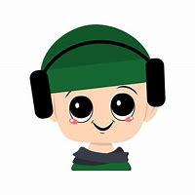
Hello my name is Javier I live in Murcia, Spain. My favourite colours are black and red. I live in my house with my parents, my brother David who is 13 years old and my dog Queen. I am 10 years old and I like playing football and videogames in my freetime. My favourite food is eggs and I hate brocoli. My favourite subject is Arts and Craft. My worst subject is maths.
a

Slide 7
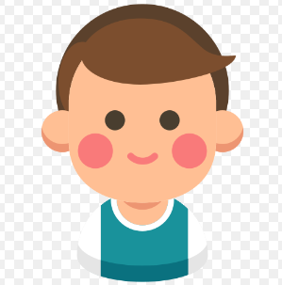
My presentation
Hello my name is Javier I am ten years I'm from Espain , Murcia my favourite subjects is p.e because it is very funny and interesting . My favourite sports is a football.
In my free time I am going to academy of English and a football school . I hate lentils and sometimes my brother

Slide 8
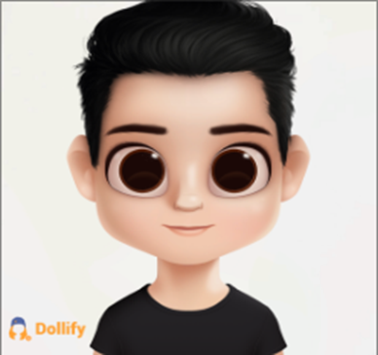
uHello.
uMy name is Fernando,I am 10 years old .I am Spanish and I live in Spain,Murcia.
uMy school is Capuchinos.
uAlso my favourite meals are : Meat,friten eggs and roast of chicken.
uMy favourite sport is football. In my free time ,I play with my tablet and friends. I like playing football and video games. I hate when I'm studying, and my brother bothers me.

Slide 9
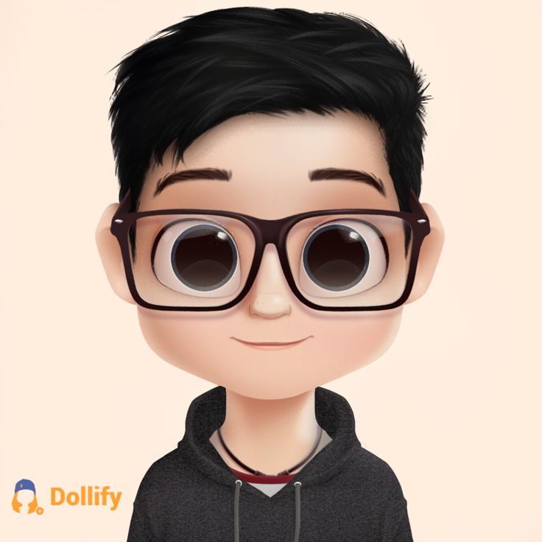
MY LIFE
Hello, my name is Alvaro Moreno,
I like playing lots of sports: football, tennis, table tennis...
I´m 10 years old and 5 months.
I like pasta, pizza, fruit, (I´d like all food),
I have glasses and I like maths, P.E. and french.
My friends called me More with my surname.
I live in Murcia and I like animals but I don´t have anyone.

Slide 10
Hello!!
My name is Adriana and I am 10 years old.
My favourite animal is the dog that’s the reason of the picture .
In my free time, I like drawing or listening to music
I am in5th of primary in the school
My favourite subject is PE
My favourite food is pasta and my favourite sport is riding a horse .

