Slide 1
Colegio San Buenaventura Capuchinos
5ºA

Slide 2
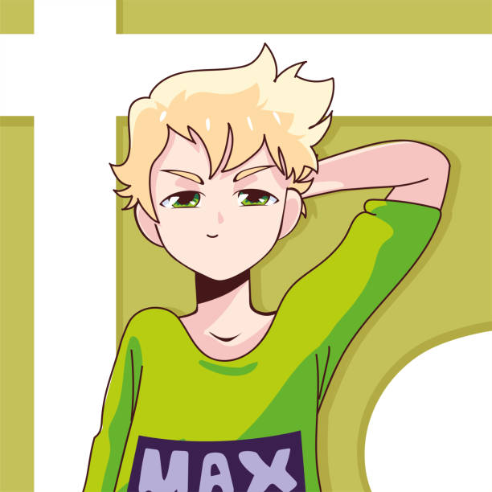
Pepe introduction
My name is Pepe, I´m 10 years old. I have one sister, I live in Murcia. My favourite music is reguetton and my favourite singer is Central Cee. I like playing football. My favourite animal is the linx, my favourite food is the pizza.
I like hearing music, I like playing Fortnite, I like meeting up with my friends
I hate natural science and language, and I hate stain my clothes.
My hobby is the drill

Slide 3
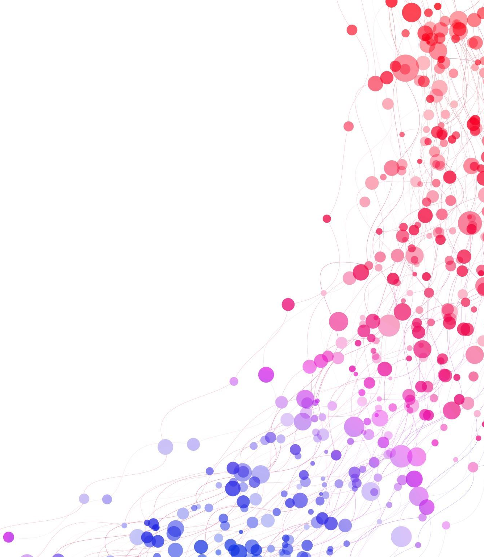
My name is Pablo. I am 10 years old . I live in Spain . I do not have brothers. My favourites sports are paddle and football. My favourite animal is the lion. My favourite food is rice with tomato. My favourite videogame is fifa 23. I like playing nintendo switch.
Paris, London and Barcelona

Slide 4
Miguel introduction
My name is miguel,i am 10 years old,i live in Murcia Spain. My favourites hobbies are play football, tennis, paddel and ping pong and i like playing videogames like fortite o fifa.
I am blond and my eyes are blue. My favourite food is meat with potatoes
My favorite subjet is P.E. I live with my parents and with my brother Jaime.
I hate language. My surnames are Gimenez Galiano. My favourite animal is monkey, my favourite music is raggeaton

Slide 5
Paris, London and Barcelona Project
Hi, My name is Lucia,I am 10 years old I am from Murcia, Spain. My favourites sports are dance and gymnastic and my favourite food is pasta with tomato and I hate cheese. My favourite animal is goat , My favourite music is regatton. My hobbies are dance and play basketball, I have 1 sister, 1 brother and 1 pet, a dog. My birthday is the 14th august . I like play with my friends but I don't like read

Slide 6
Paris, London and Barcelona Project Hello my name is Laura. I`m 10 years. My country is Spain. My birthday is 3th of February of 2013. My favourite is pop Spain music. I have a dog. I´m in the middle, have the eyes brown, the hair brown and curly. I have a sister a mom and dad. My favourite sport is basketball. My favourite animal is the dog. My favourite food is the pasta. I like the colour blue, playing with my dog, and I hate the football. My hobbies are: basketball and playing guitar.

Slide 7
Juan introduction
My name is Juan,I am 10 years,my dad call Juan Antonio and my mum Maria, and have a salchiche dog called LUCA.I live in Murcia Spain .my surname is Yañez and cantabella.My favourite food is the MY favorite music is the POP,my favourite sport is the basketball and my favorite animal is the Leopard and food is the SUSHI.

Slide 8
My name is Jesus i lived in Murcia Spain.
my favorit videogames is fortnite.
I am 9 years old .
my birthday is in 24 the Novenber the 2013
my favourite sport is football
my favourit music is regaetton
my favourit animal is the dog

Slide 9
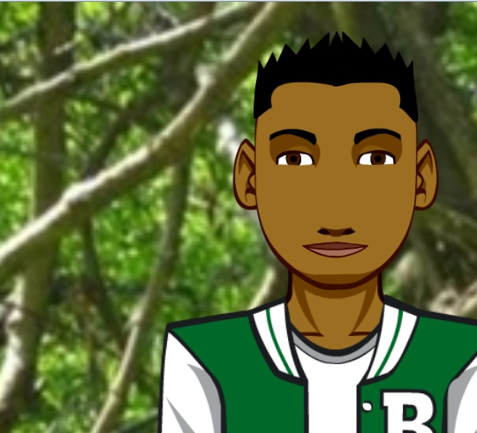
Jesús introduction
My name is Jesús,I live in Murcia Spain.I like playing football,basket and playing some videogames
My style is drill
my favorite food is meat.
I am tall and big.I have one sister.
My favorite subjet is Physical Education.
My surname is Jimenéz Manzanera.
My favorite music is drill.I am 10 years old.I live with my parents and with my sister.
I hate language and natural science.My favorite animall is dog.
My hobbie is dance drill, earing music driller,dembow and raggaeton.

Slide 10
London, Barcelona and Paris proyect
Hello my name is Enrique, I´m 10 years old . I´m from Spain and I live in Murcia with my mum and my cat. I study at 5th of primary school, my favorite subject is physical education, I also like math but it´s a little hard.
My favorite sport is soccer

Slide 11
PARIS,LONDON AND BARCELONA PROYECT
Hello I´m Alejandra ,I live in Murcia, Spain. My favourite sport is basket but I´m not very good. I love arts and crafts. I´m very good at making miniature models of houses.
I like reading and playing table games.
My favourite food is oven rice and my favourite drink is Nestea but I drink it on special dates.
My favourite subject is Social science. I also like to play with plasticine.
My favourite colours are blue and purple .I´m tall ,my hair is very curly and my eyes are blue .I´m ten years old. By.

Slide 12
Alberto
My name is Alberto, I am 10 years.
I have a sister: Marta
A dog: pinta
My mother name is Ana, and my father name is Manolo.
I live in Murcia.

